Slide 1

COMPUTER NETWORK BCSC0008

Slide 2
UNIT- I
Introduction Concepts: Goals and Applications of Networks, Network structure and architecture, The OSI reference model, services, Network Topology Design, Physical Layer Transmission Media, Line coding scheme, switching methods (circuit switching, Packet switching), TDM.
Medium Access sub layer: Medium Access sub layer - Channel Allocations, LAN protocols - ALOHA protocols, CSMA, CSMA/CD, Overview of IEEE standards
Data Link Layer –Error detection and correction, Flow control (sliding window protocol)

Slide 3
UNIT- 2
Network Layer: Network Layer –IP addressing, subnet, CIDR, VLSM, Internetworking, Address mapping, routing. Connecting devices. Introduction to IPv6, transition from IPv4 to IPv6.
Transport Layer: Transport Layer - Design issues, connection management, Flow control, TCP window management, congestion control-slow start algorithm
Application Layer: Data compression, Data Encryption, File Transfer, DNS, HTTP, SMTP, TELNET.

Slide 4
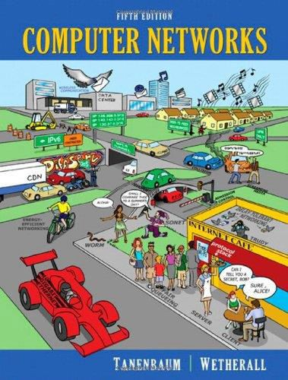
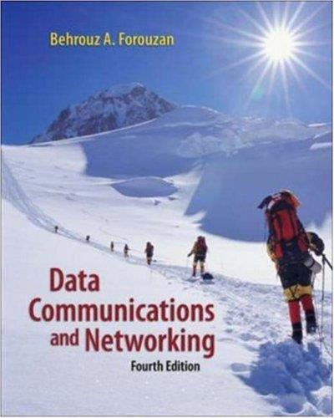
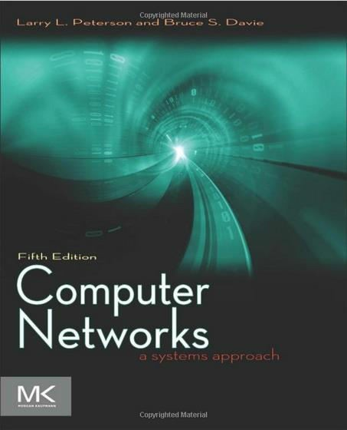
Suggested Books

Slide 5
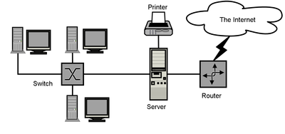
Computer Network
Computer Network is a group of computers connected with each other through wires, optical fibers or optical links.
The aim of the computer network is the sharing of resources among various devices

Slide 6
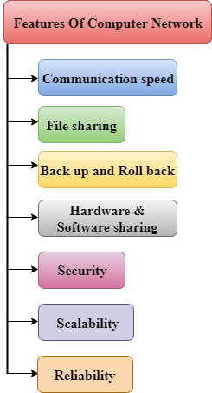
Features of
Computer Network

Slide 7
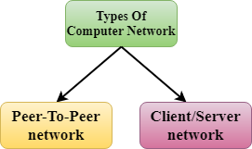
Computer Network Architecture

Slide 8
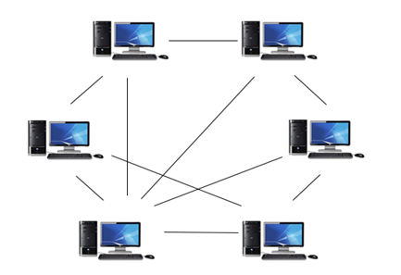
Peer-to-Peer Network
All the computers are linked together with equal privilege and responsibilities for processing the data.

Slide 9
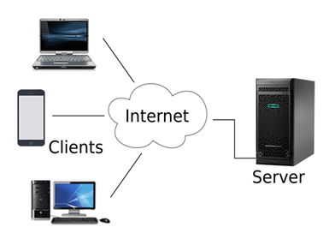
Client/Server Network
Client/Server network is a network model designed for the end users called clients, to access the resources such as songs, video, etc. from a central computer known as Server.

Slide 10
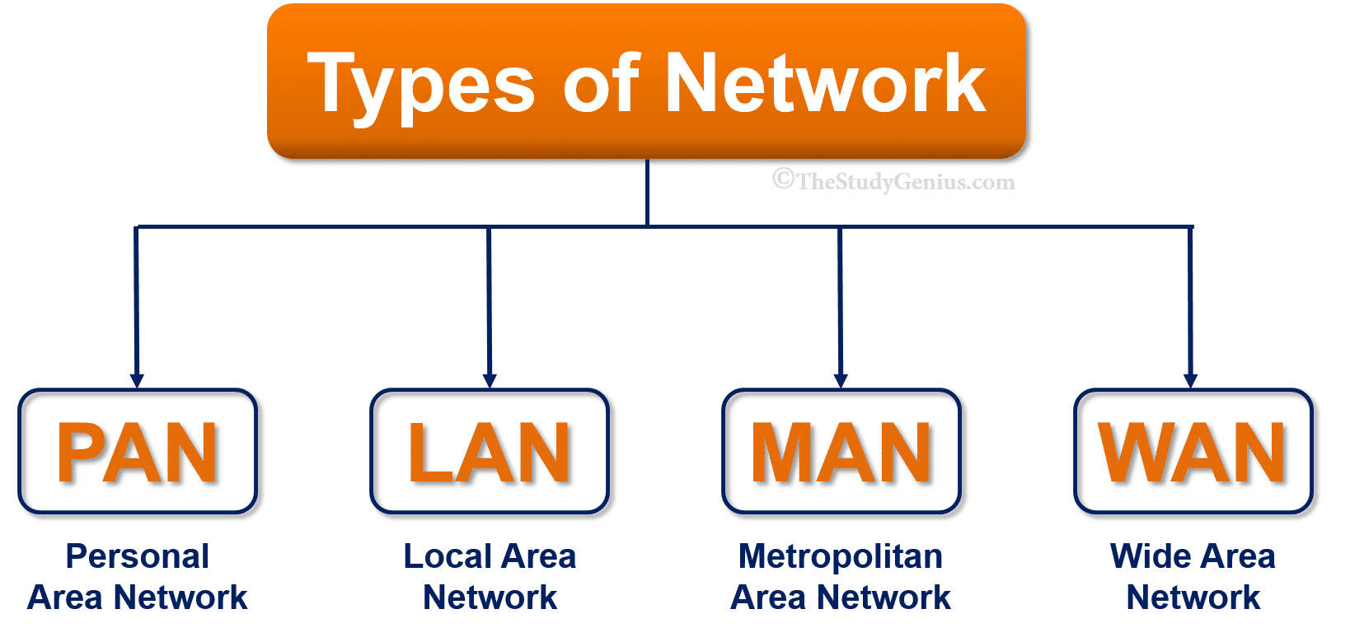
Types of Computer Networks

Slide 11
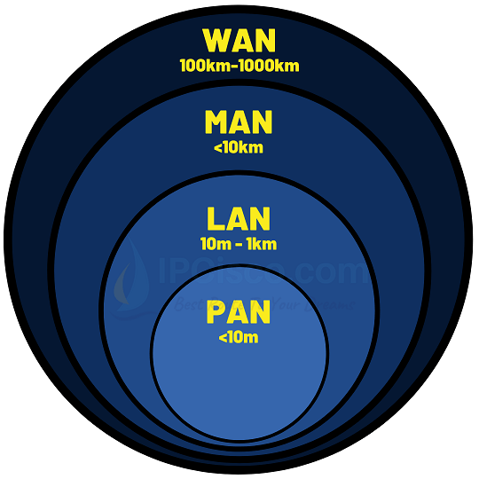
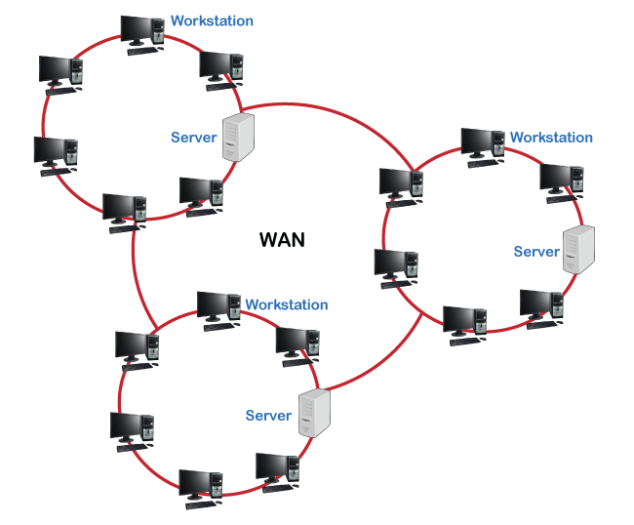
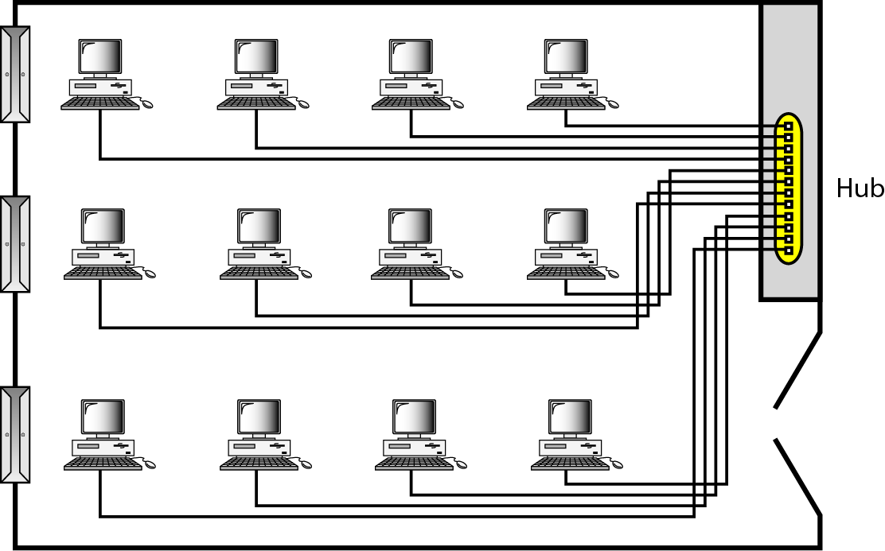

Slide 12
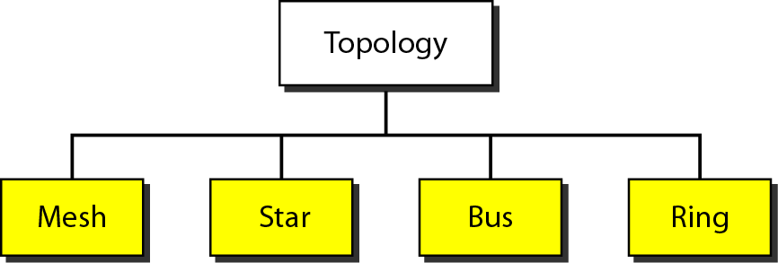
Network Topology
Structure of the network of how all the components are interconnected to each other.
Tree

Slide 13
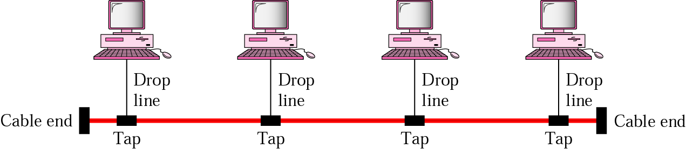
Bus Topology
A multipoint topology
All devices are linked through a backbone cable
Nodes are connected to the bus cable by drop lines and taps.
Advantage:
Ease of installation
Disadvantages:
Difficult reconnection and fault isolation
Broken or fault of the bus cable stops all transmission

Slide 14
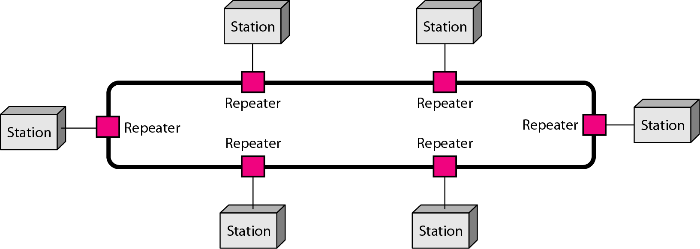
Ring Topology
Each device is dedicated point-to-point connection only with the two devices on either side of it.
A signal is passed along the ring in the direction, from device to device, until it reaches its destination.
Each device in the ring incorporates a repeater.
Advantages
Relatively easy to install and reconfigure
Fault isolation is simplified
Disadvantage
Unidirectional traffic

Slide 15
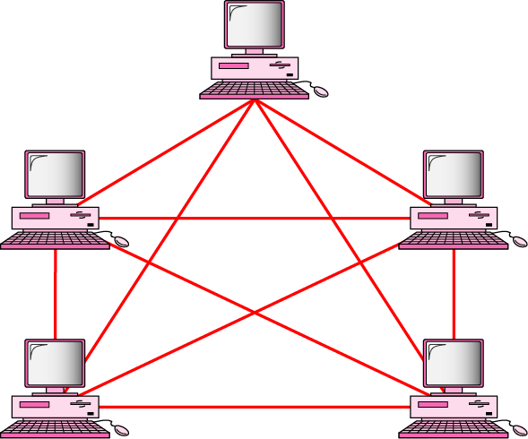
Mesh Topology
Every device has a dedicated point-to-point link to every other devices
Dedicated
Link carries traffic only between the two devices it connects
A fully connected mesh network has n(n-1)/2 physical channels to link n devices
Every device on the network must have n-1 input/output (I/O) ports
Advantage
Less traffic, robust, secure, easy to maintain
Disadvantage
Need more resource (cable and ports), expensive

Slide 16
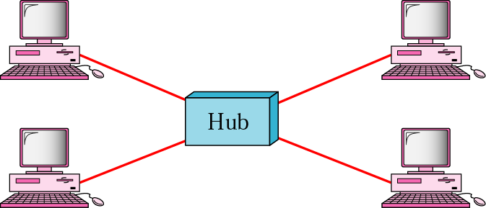
Star Topology
Each device has a dedicated point-to-point link only to a central controller, usually called a hub.
No direct traffic and link between devices
Advantages
Less expensive
Easy to install and reconfigure
Robustness
Disadvantage
Single point of failure

Slide 17
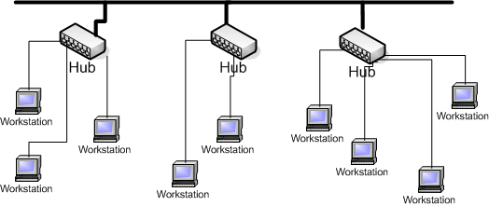
Tree Topology
Advantages:
Point-to-point wiring for individual segments.
Supported by several hardware and software venders.
Disadvantages:
Overall length of each segment is limited by the type of cabling used.
If the backbone line breaks, the entire segment goes down.
More difficult to configure and wire than other topologies.

